Slide 1

FaceMusic
Emotions = Music
https://www.youtube.com/watch?v=qLjUGwrKTVs
https://github.com/almogre02/FaceMusic

Slide 2
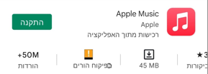
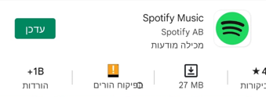
Goals
Present:
The main purpose of the app is to be added as an add-on to music apps like Spotify, Apple Music (they have about 1 billion and 50 million downloads respectively).
Future:
If the app will succeed, the goal will be to expand into the movie market. The idea: after the shoot, the user will be shown a list of movies according to the emotion he identified (for example: on Netflix, there are categories for each movie: fear, comedy and more .. those categories related to our set of emotions).
Connection with Voice Recognition - Using voice recognition to recognize emotions, a user records a sentence and shortly afterwards the app recognizes the related emotion.
Currently we have not found any similar app.

Slide 3
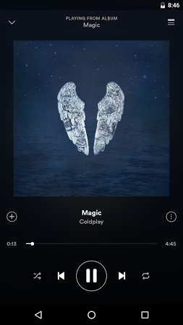

Business goals:
It is currently intended to be used as an add-on to well-known music apps such as: YouTube, Apple Music, Spotify, etc.
Artists will also be able to purchase Creator users, match their songs to the right emotions, and upload them to the app, exposing their songs to a new audience.
By adding another method other than searching for a song by name, music apps can expand their target audience

Slide 4
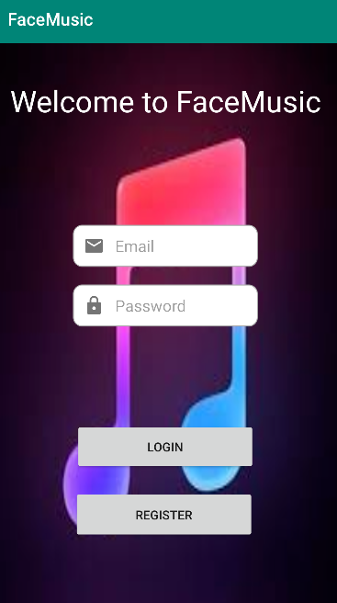
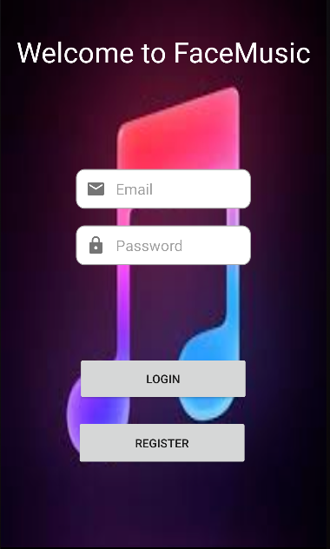
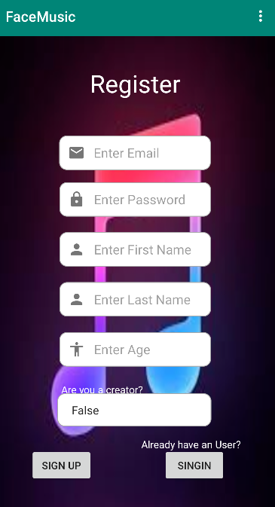
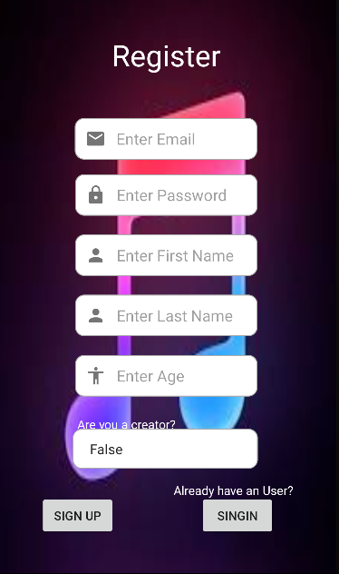
Register and Login
Text input – Email form (****@****.***), Verify that the user has entered the appropriate text
Text input – Masking the users password ,Verify that the user has entered the appropriate text.
Login Buttons - sends request to FireBase database to login and awaits respond.
Register Button – sends to Register screen
Text input – Email form (****@****.***), Verify that the user has entered the appropriate text
Text input – Masking the users password ,Verify that the user has entered the appropriate text.
Text input – Regular text
Text input – Number text
Spinner – Bollean Spinner.
SignUp Button - sends request to FireBase database to register the user, Verify that the user has entered the appropriate text.
SingIn Button – sends to Login screen.

Slide 5
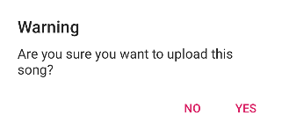
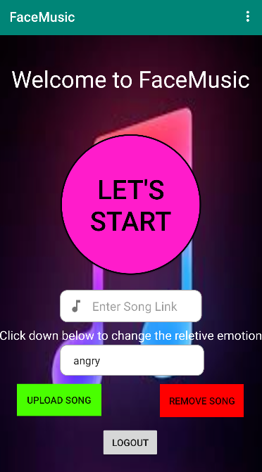
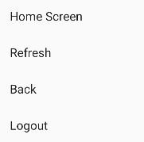
Creator User
Menu Button – Open menu.
Popup Message after cliking Upload Song / Remove Song Buttons.
Let’s Start Button – Sends the user to the emotion detection.
Text input – Link of the YouTube video you want to upload.
Upload Song Button – sends request to FireBase real time database to add the song.
Logout – Logout the user and sends to login screen.
Emotion Spinner – Choose the emotion associated with the song you want to upload.
Remove Song Button -Verify that the song is is the database. sends request to FireBase real time database to delete the song.

Slide 6
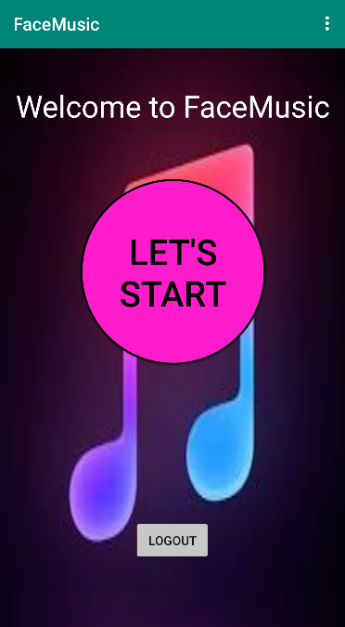
Client User
Let’s Start Button – Sends the user to the emotion
detection.
Logout – Logout the user and sends to login screen.

Slide 7
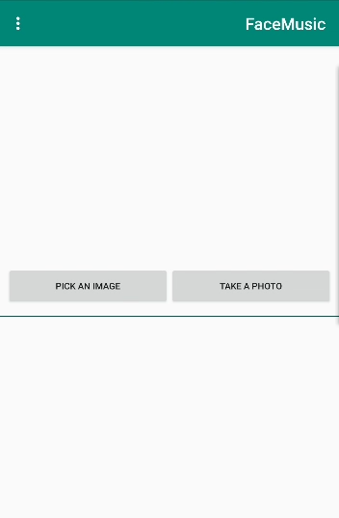
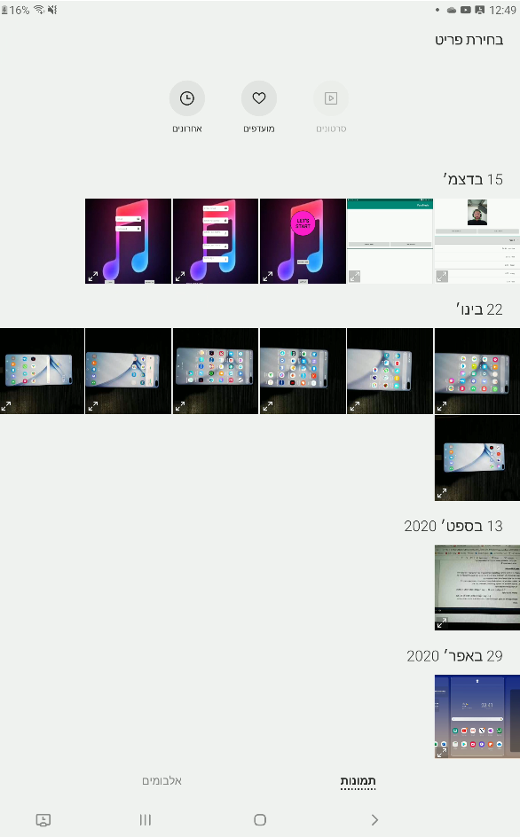

Main Activity
PICK AN IMAGE Button – Opens the gallery on the user's phone.
TAKE A PHOTO Button – Activates the camera on the user's phone.
Try Again Button - Reactivates the camera
on the user's phone.
Confirmation Button – Sends the user to the
image diagnostic results .

Slide 8
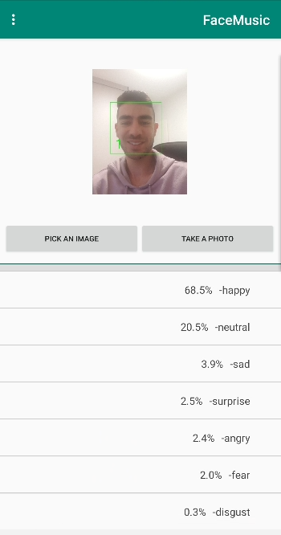
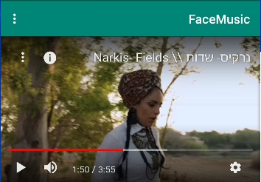
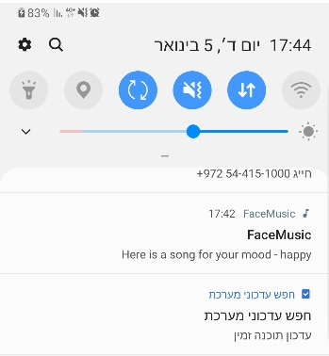
YouTube
Image diagnostic results
Plays the song based on the feeling
Activates a random song from the Firebase
Realtime Database based on the emotion detected
from YouTube.
A notification is sent to the user's phone with the relative emotion.

Slide 9
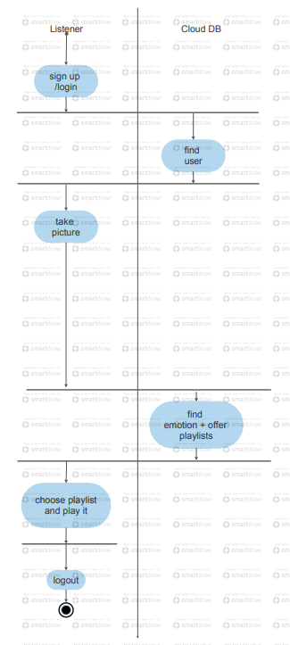
Activity Diagram

Slide 10
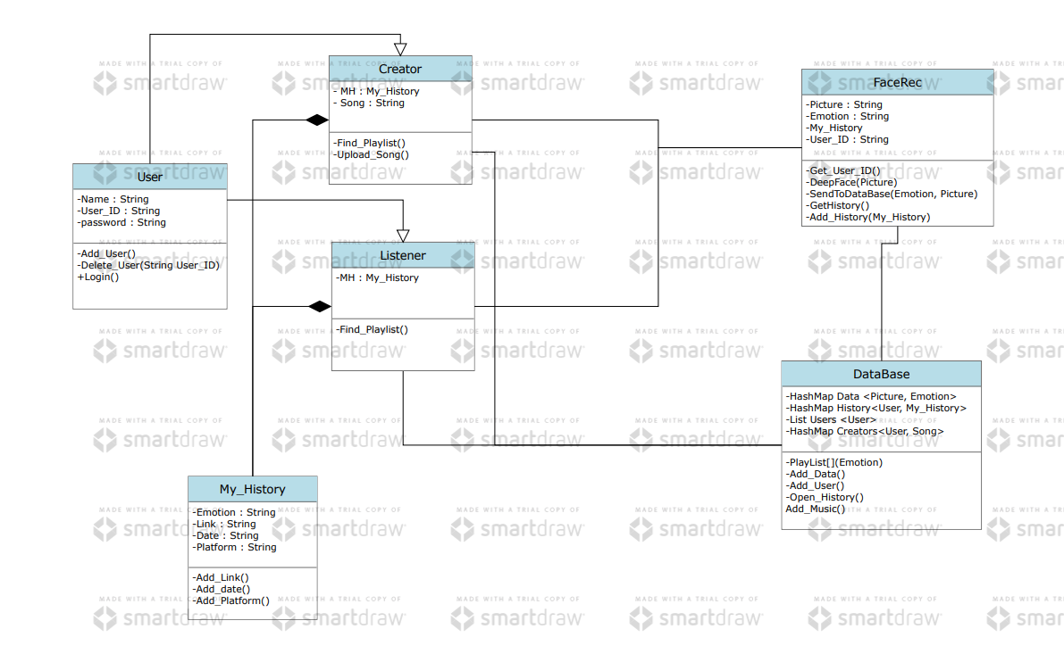
Class Diagram

Slide 11
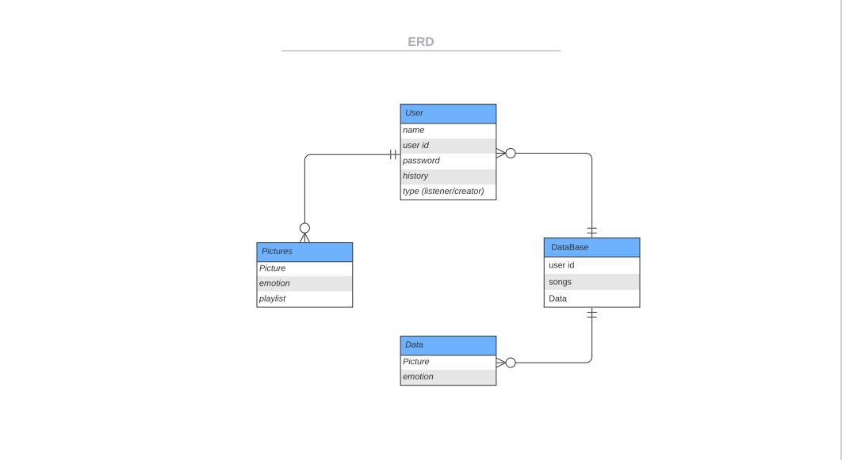
ERD

Slide 12
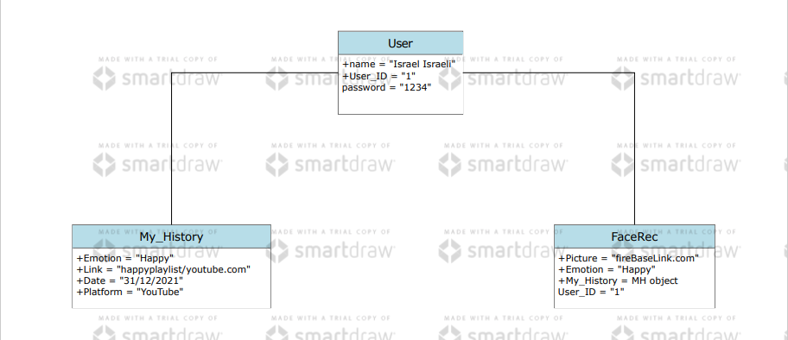
Object Diagram

Slide 13
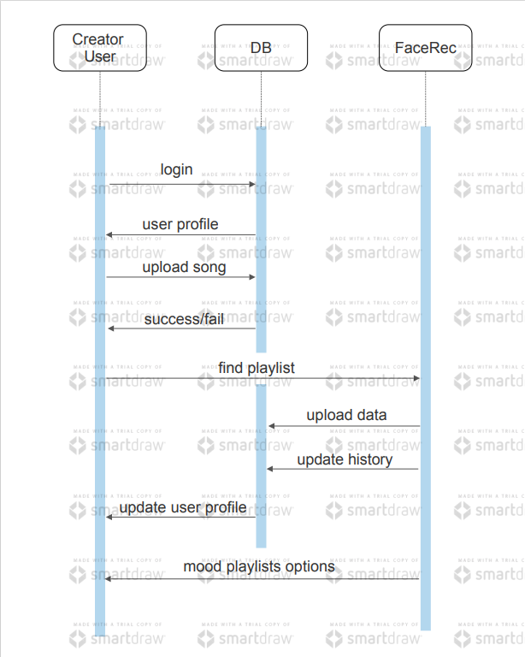
Sequence Diagram

Slide 14
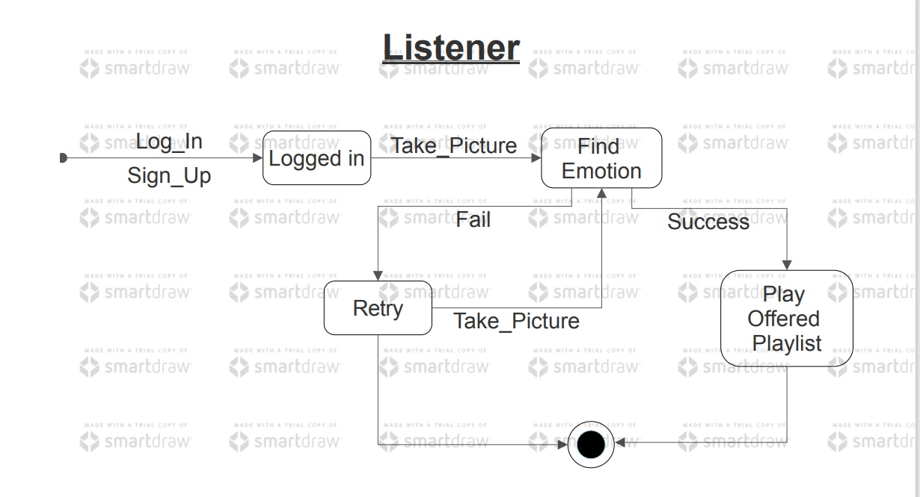
State Machine Diagram

Slide 15
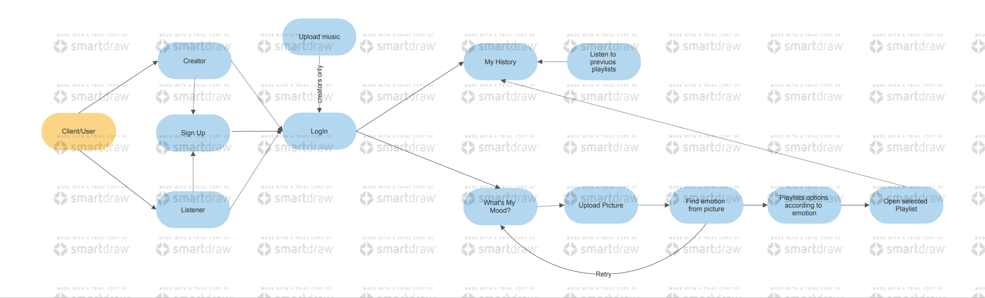
Use Case

Slide 16
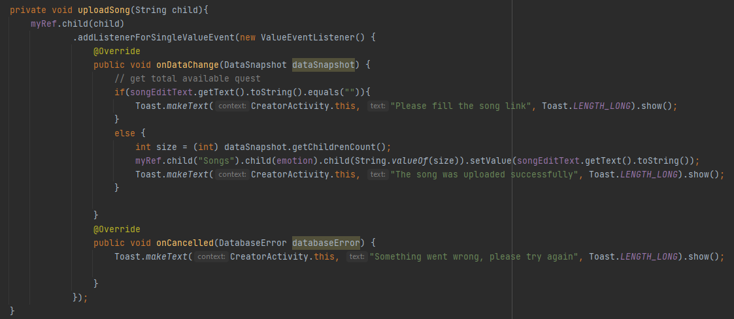
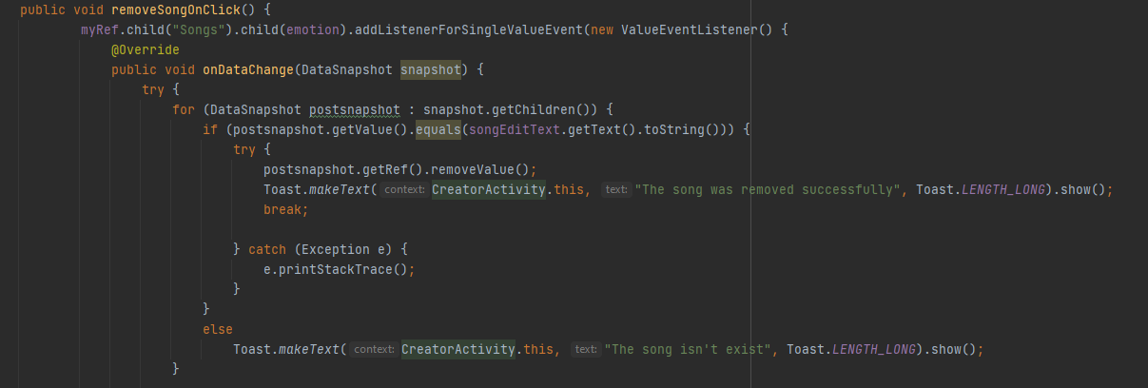
Objects and Methods
Creator Class
Upload Song Method - Gets the relative index indicating the location in which to upload the song. Use this function to upload the song to the Firebase Realtime database. Uploaded songs are associated with the relative emotion the creator entered.
Remove Song Method - Moves over all the songs and checks if the relative song is present, if it is, this function removes that song from the Firebase Realtime database, otherwise it sends a message saying that the song does not exist

Slide 17
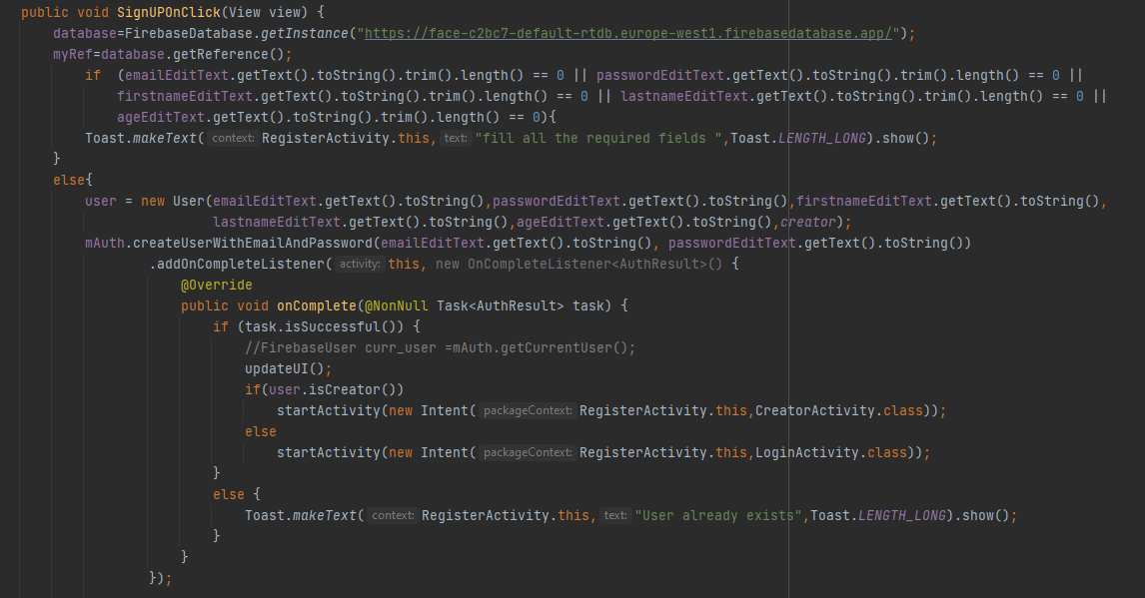

Objects and Methods
Register Class
SingUpOnClick - In this function, the user is entered into the Firebase Realtime database. The user's personal details are obtained from the details that the user enters within the application. If you don't fill out all the fields, you will be allerted
UpdateUI - this method push the user details
to the firebase real time database

Slide 18
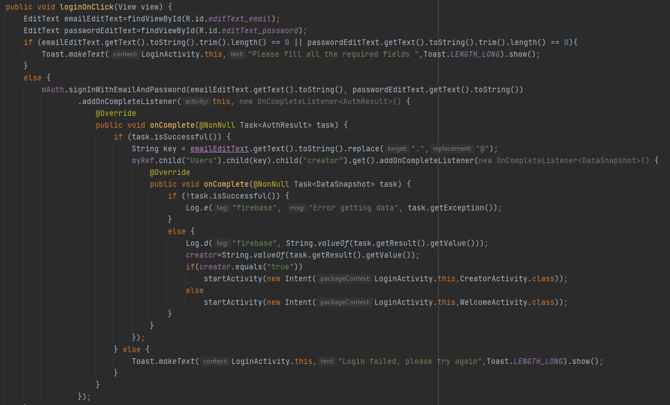
Objects and Methods
Login Class
LoginOnClick - Verification of the user in the Firebase Realtime database, by checking the email and password with which he registered for the application. If you don't fill out all the fields, you will be allerted

Slide 19
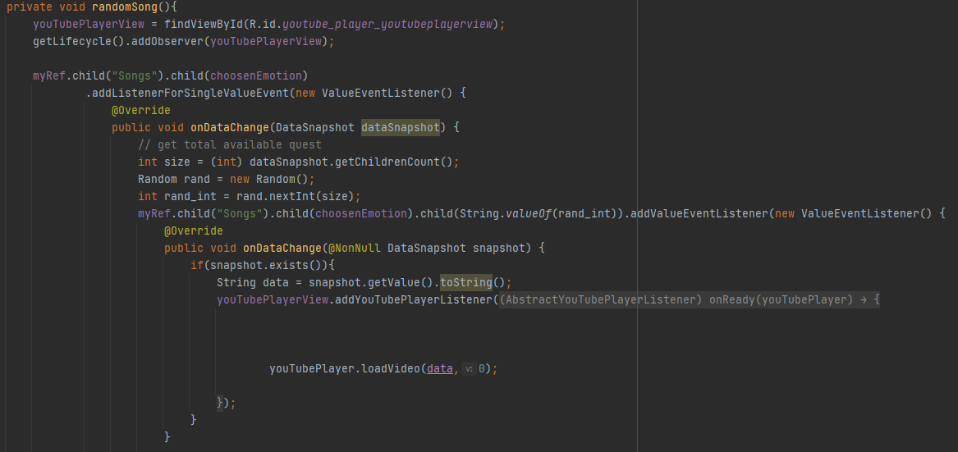
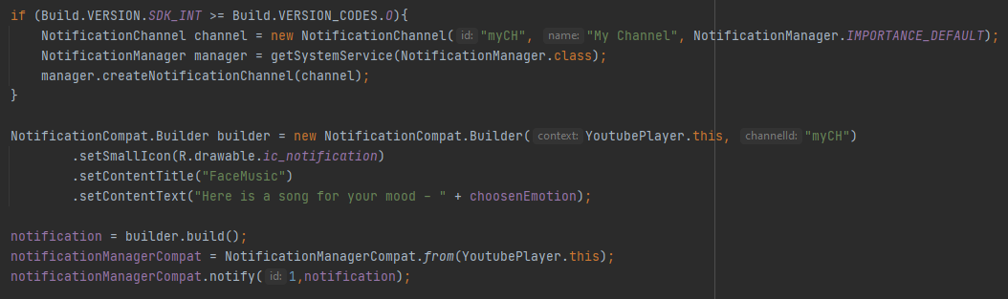
Objects and Methods
YouTube Player Class
RandomSong - this function gets access to the Firebase Realtime database and then runs a song on YouTube randomly from a list of songs that are categorized for the same emotion by the creators.
Notification – after the emotion detection the user will be notify the chosen emotion.

Slide 20
Objects and Methods
FaceRec Class
Open source code. The dataset is trained with a Convolutional Neural Network model.
It contains 46,614 images.
The model provide output that consist of probabilities for each class:
angry
disgust
fear
happy
neutral
sad
surprise

Slide 21
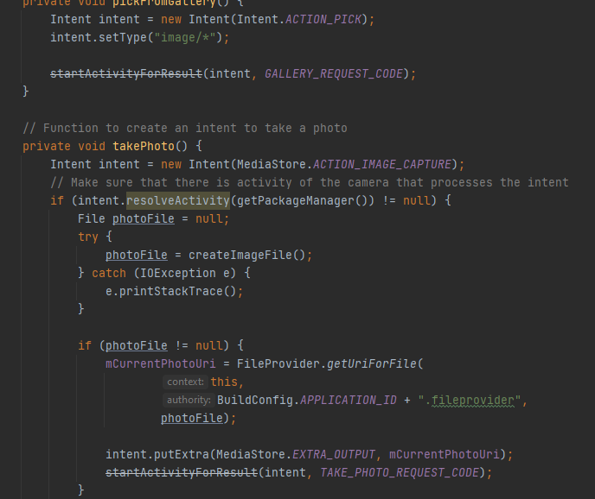
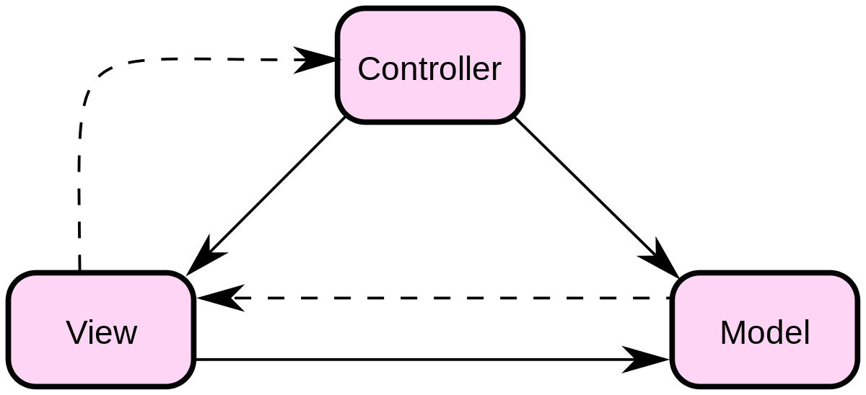
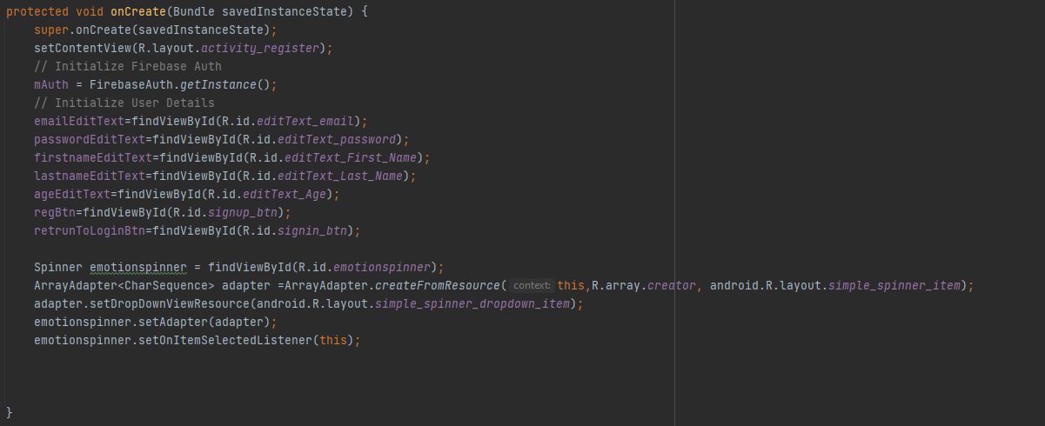
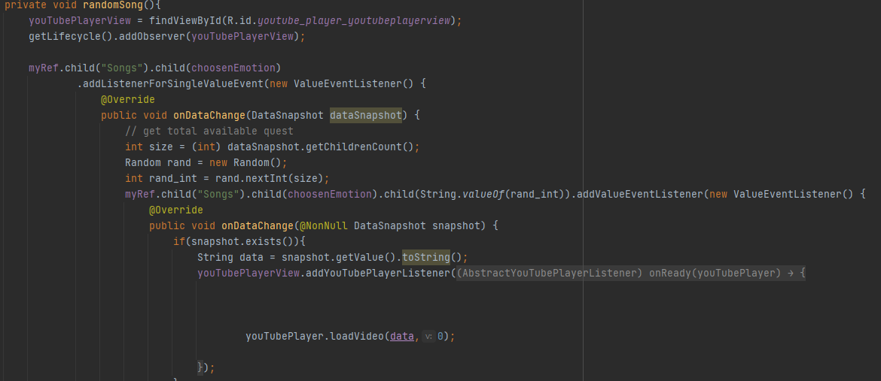
Models
MVC

Slide 22
Summery
Our project is developed using Android-Studio, using YouTube player and Face Recognition open source code.
Our Project allows:
Users to enjoy music based on the emotion they display.
Creator users to upload / remove songs from the database
Each emotion has a different number of songs, when the face recognition detect the right emotion a song will be played randomly from the list of songs in FireBase real time database.
There are 2 types of users:
Client user
Creator user

Slide 23
Gaps
Users have direct access to their own personal history - the last detected emotions and songs are saved and displayed on a dedicated screen.
When the app recognizes a face and selects a song, it allows the user to rate the selection and recognition on a scale of 1 to 5 for the purpose of improving the app.
For the creator user, payment will be required in order to publish his songs (by classifying them according to emotions). In addition, creator user will be required to upload appropriate and proper content. (The creator will have to sign an agreement and go through a number of verification steps before receiving the appropriate permissions) .
Contact selected applications such as: Spotify, Apple Music for reviews and business contact.

